Slide 1
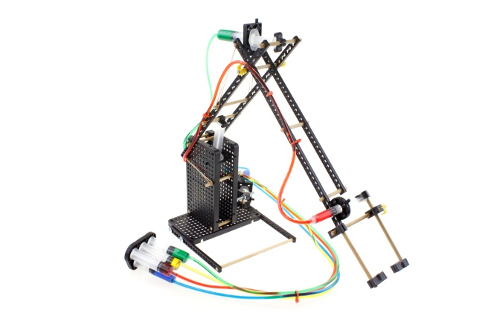
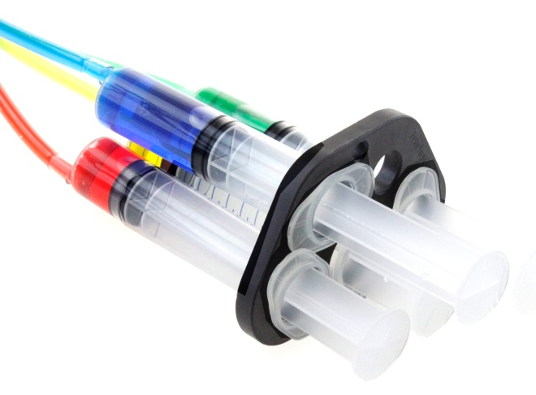
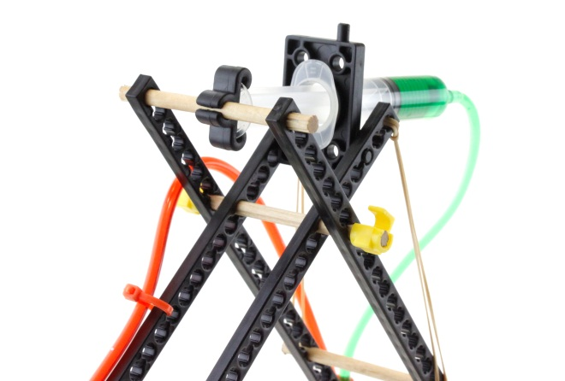
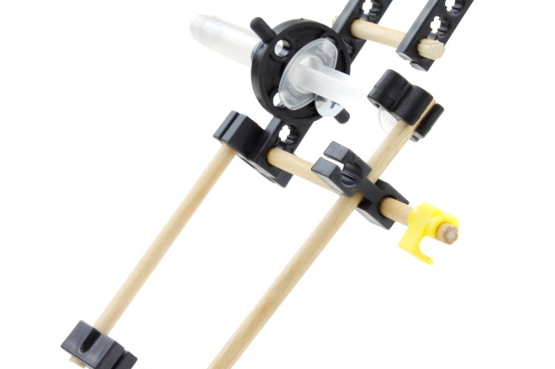
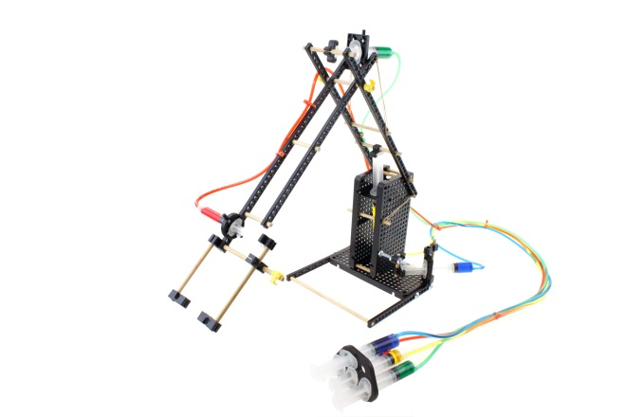

Slide 2
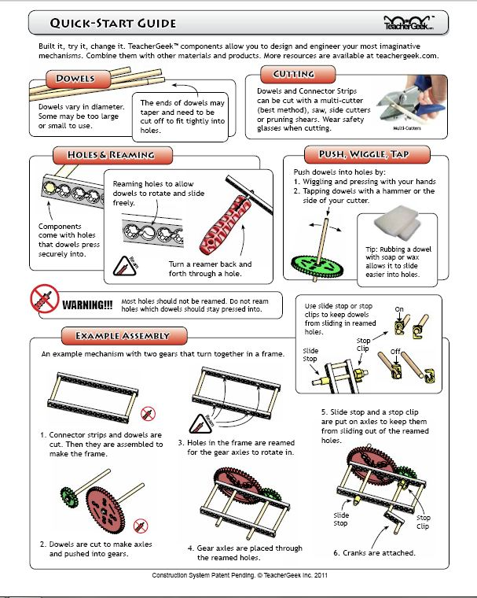
QUICK-START GUIDE
The TeacherGeek Quick-Start Guide provides a great reference for techniques, tools and tips used to assure successful building.
Before beginning construction, take time to review this important information..
Click on this image to open the full PDF document.

Slide 3
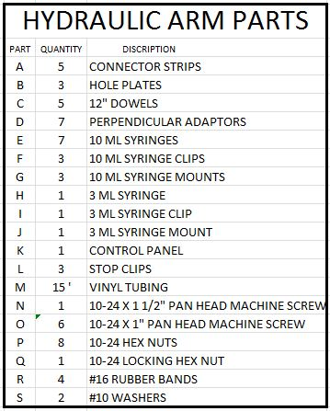
A
B
C
D
F
G
K
E
L
I
N
M
O
H
R
S
J
P
Q

Slide 4
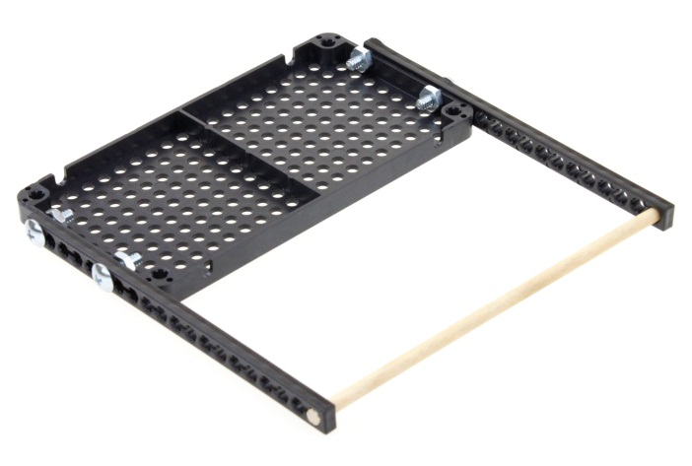
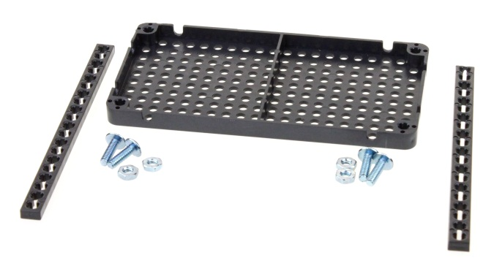
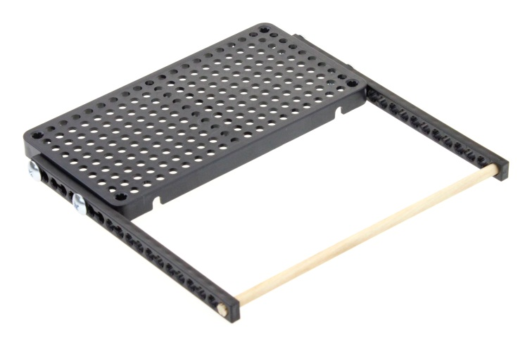

CREATE BASE PLATFORM
2
Using four 10-24 x 1” machine screws and hex nuts, assemble the support legs to the ends of the hole plate on both sides as shown.
Cut one dowel to 170mm (~6 ¾”). Insert into both end holes of connector strips.
1
Cut one 300mm connector strip into two equal 150mm pieces.
Finished Bottom View
Finished Top View

Slide 5

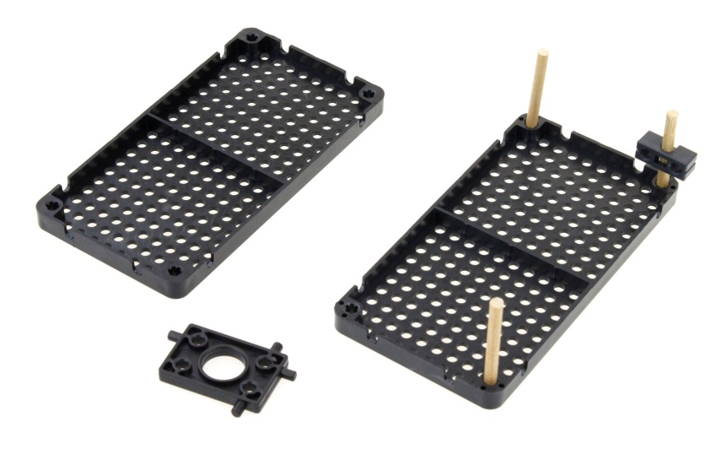
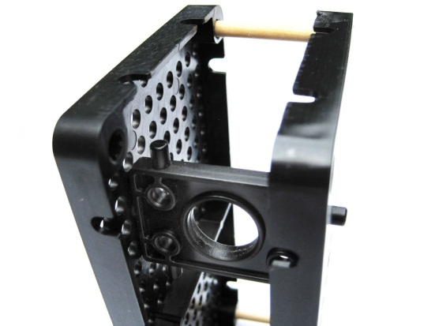
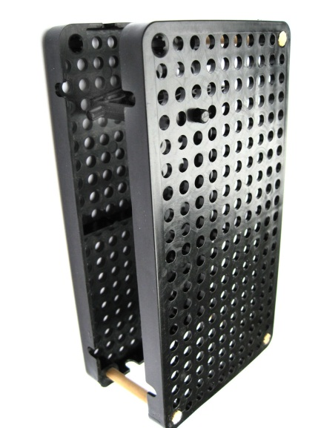
CREATE ROTATING ARM SUPPORT
5
Place the other hole plate over the dowels and insert the syringe mount into the hole that is down four holes from the top and in three holes from the side as shown.
Tip: Syringe mount is placed in the corner area with no dowels. Be sure to install the mount in the horizontal direction as shown.
3
Lay two hole plates bottom side up on a flat surface.
4
Cut three dowels 51mm (~2”)
Insert dowels into corners as shown.
Slide one perpendicular adaptor on to the corner dowel as shown.
Four Holes Down
Three Holes
Over

Slide 6
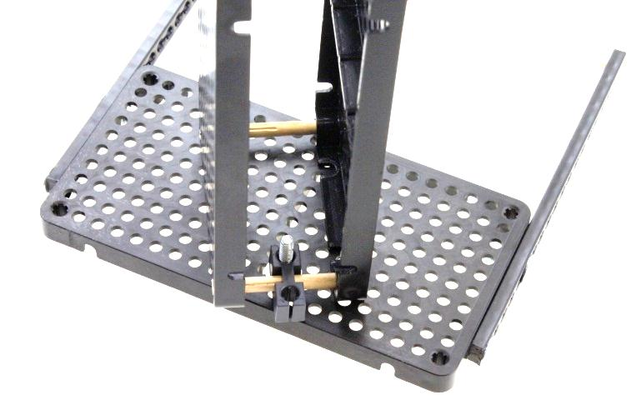
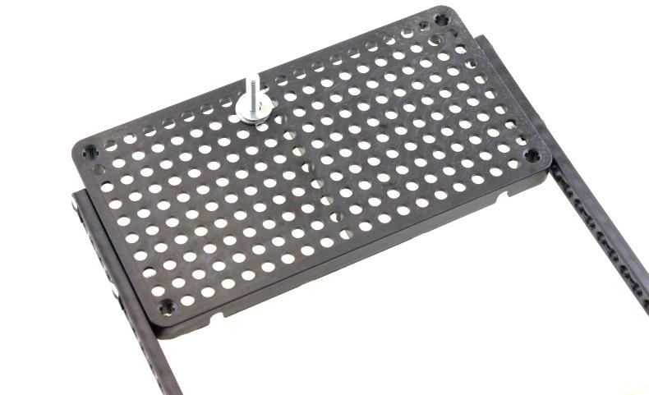
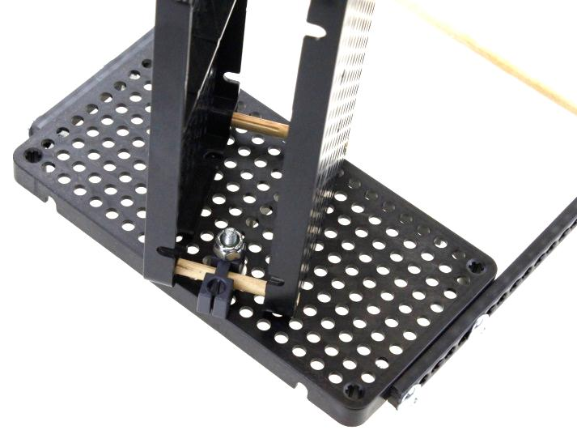

ATTACHING SWIVEL ARM SUPPORT TO BASE
6
Place 10-24 x 1” machine screw from the bottom of the base through the hole that is 9 holes over in the 2nd as shown. Place two #10 washers over the bolt.
7
Place the inside hole of the perpendicular adaptor that is mounted to the swivel arm support over the washers on the machine screw.
2nd row
9 holes over
8
Place 10-24 locking hex nut on the screw and tighten.
Loosen the locking nut just enough so the swivel arm support can rotate freely.

Slide 7

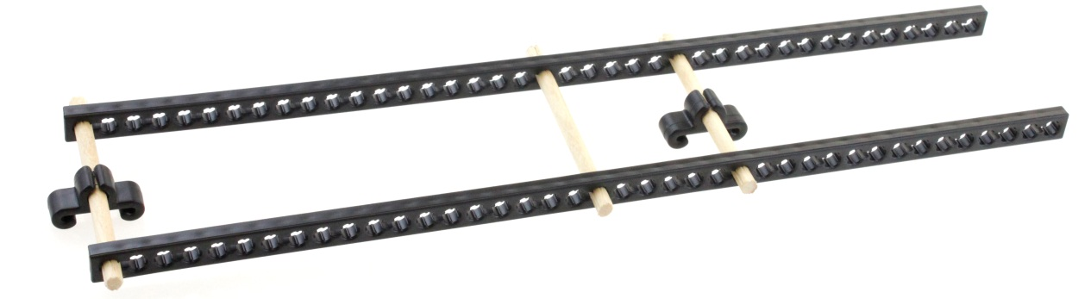
BUILDING THE LOWER COMPONENT OF THE ARM
9
Cut three dowels 76mm (~3”).
Ream the holes on two large syringe clips.
Slide large syringe clips on two of the dowels.
To assemble as shown insert a dowel with syringe clip into the first holes on both 300mm connector strips. Now insert a dowel (without a syringe clip) into the 20th holes of the connector strips. Finally insert a dowel with a syringe clip into the 26th holes of the connector strips.
Ream the 8th hole on both connector strips as shown.
Ends of all dowels need to extend 6mm (~1/4”).
26th hole
from left
8th Hole
20th hole from left
8th Hole

Slide 8
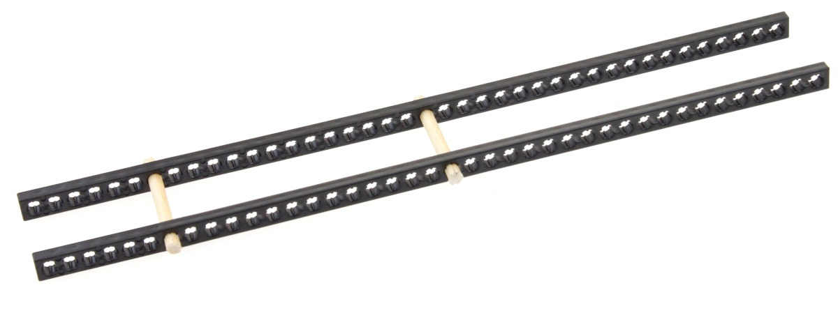
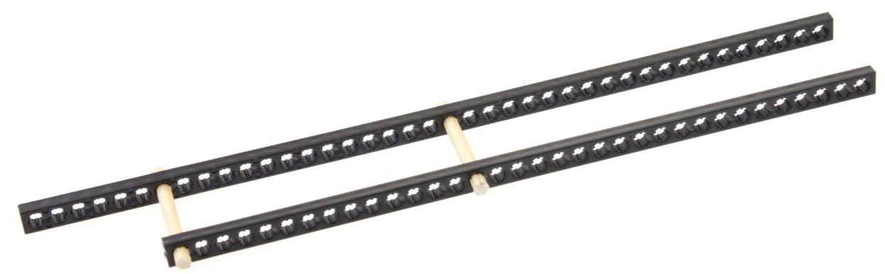
BUILDING THE UPPER COMPONENT OF THE ARM
10
Cut two dowels 51mm (~2”).
Assemble two full connector strips with the cut dowels in the 7th and 21st holes as shown.
Dowel ends should extend beyond the connector strips by 6mm (~1/4”).
21st hole
7th hole
Spacing Between Upper Arm Connector Strips is 31mm (1 ¼”)
Extend dowels 6mm (~1/4”)
Any Holes
11
Cut 45mm (~1 ¾”) off one connector strip as shown.

Slide 9
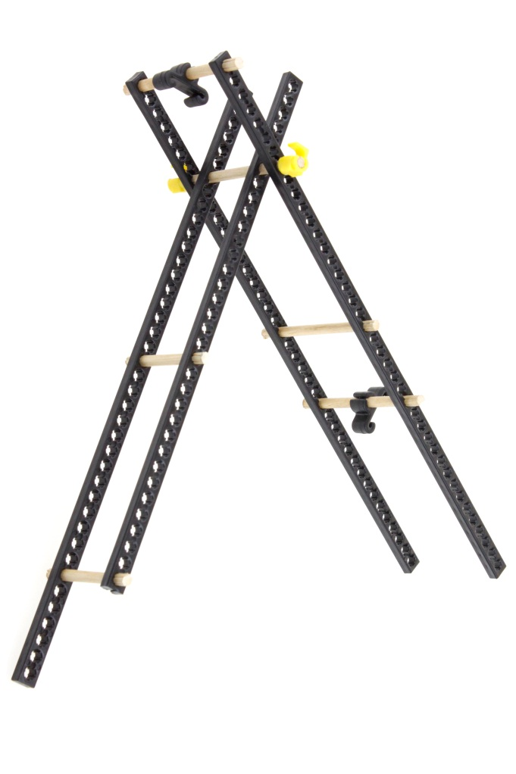
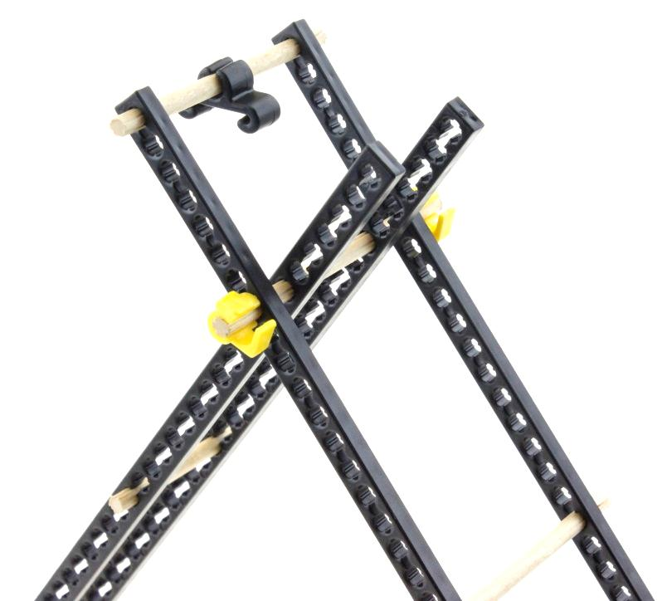
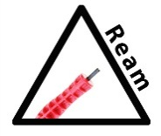
JOINING THE LOWER AND UPPER ARM COMPONENTS
12
Cut one dowel 90mm (~3 1/2”).
Insert the 90mm (3 1/2”) dowel through one reamed hole (8th from end) of the lower arm section. Then into both of the unreamed 7th holes of the upper arm component. Finally insert the dowel through the reamed hole of the lower arm component.
Spacing between the upper arm connector strips should be 31mm (~1 ¼”).
Place Teacher Geek Clips on both ends of the dowel.
Upper Arm Section
Upper Arm Section
Lower Arm Section
7th Hole
Lower Arm Section
Spacing Between Upper Arm Connector Strips is 31mm (1 ¼”)
8th Hole Reamed Both Sides

Slide 10
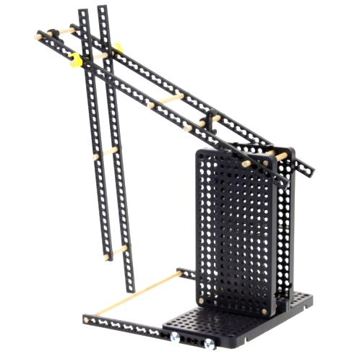
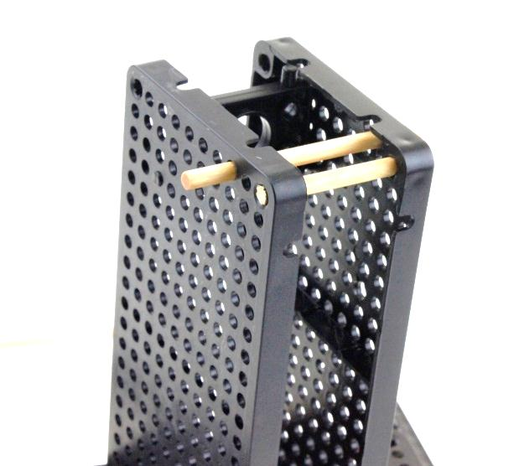
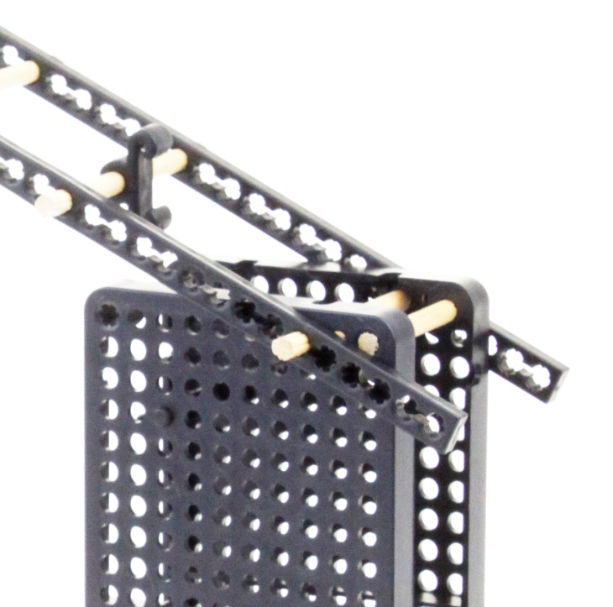
ATTACHING ARM TO THE SWIVEL BASE
14
To attach the arm to the base insert the extending dowel ends through the 6th holes on the lower arm section.
13
Cut one dowel 76mm (~3”).
Insert dowel through holes as shown so equal amounts of dowel extend past the hole plates.
Top hole of third vertical row in.
Both Sides

Slide 11
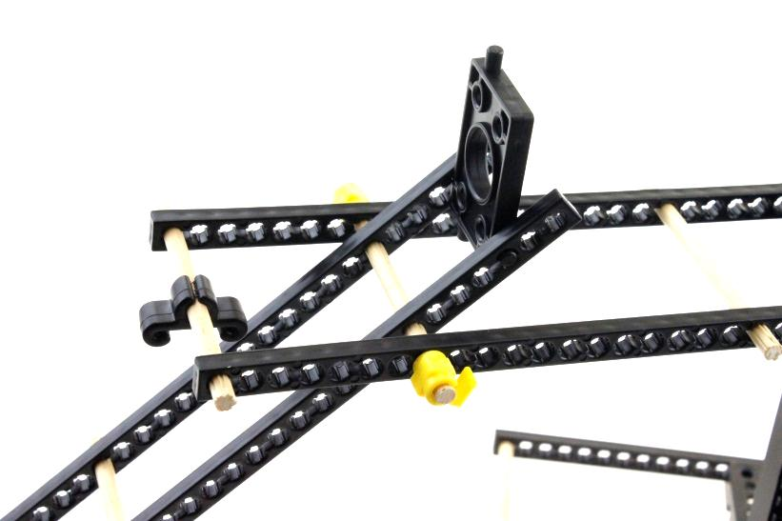
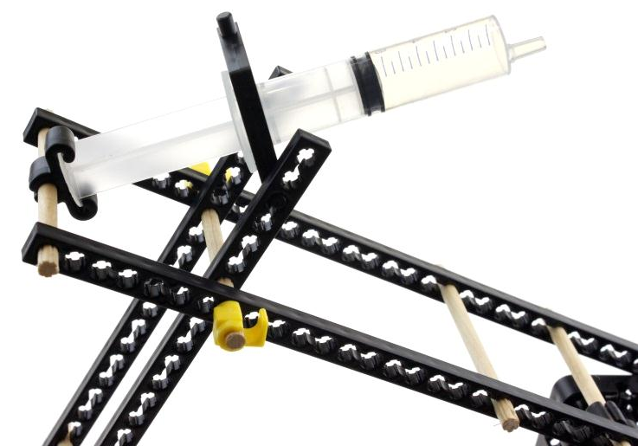
INSTALLING 10ML SYRINGE ON ARM
15
Place syringe mount pins into the 3rd hole from the end of the upper arm component.
Press 10ml syringe into the syringe mount and slide the end of the syringe into the clip as shown.
Syringe Mount
Any Holes
3rd Hole

Slide 12
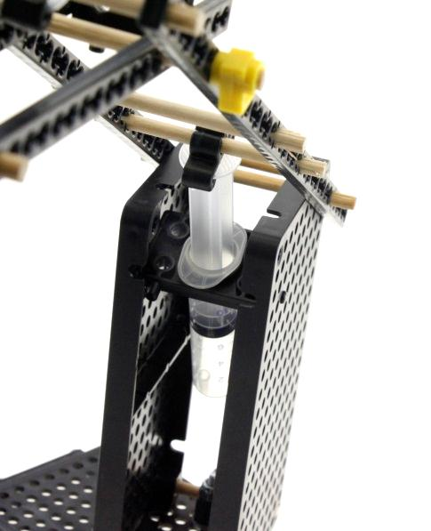
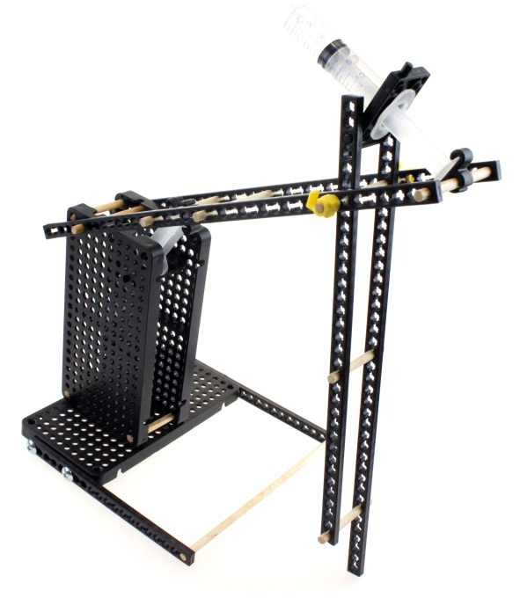

INSTALLING 10ML SYRINGE IN SWIVEL BASE
16
Press 10ml syringe into the syringe mount in the swivel base and slide the end of the syringe into the clip as shown.
Syringe
Clip
Syringe
Mount

Slide 13
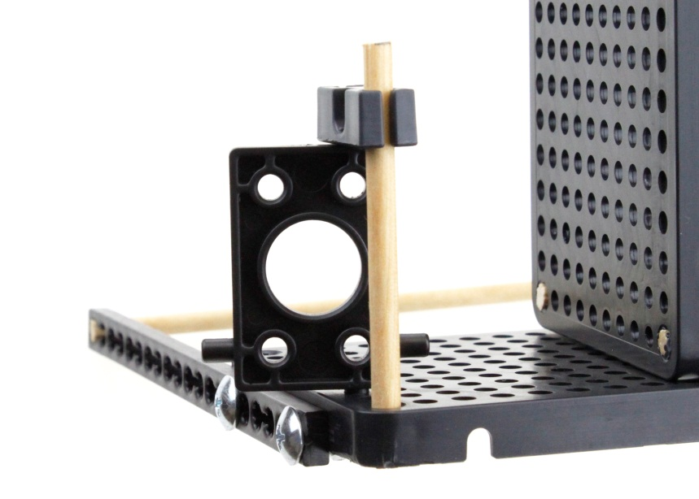
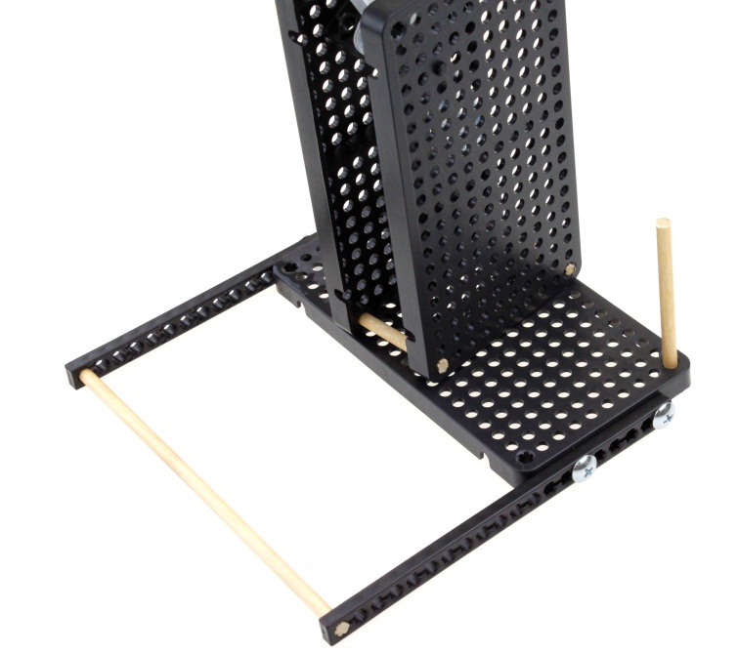
INSTALLING 10ML SYRINGE IN SWIVEL BASE
17
18
Place 10cc syringe mount in the 3rd hole from the corner on support leg side in the vertical position as shown.
Slide a perpendicular adaptor over the dowel and onto the syringe mount pin as shown.
Cut dowel 76mm (~3”).
Place in corner hole of base as shown.
Any Holes
Third hole from corner

Slide 14
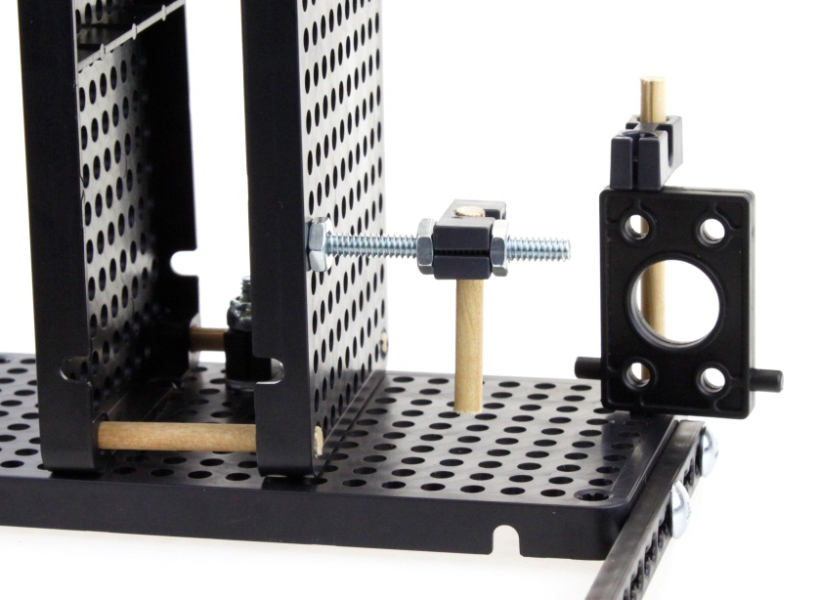
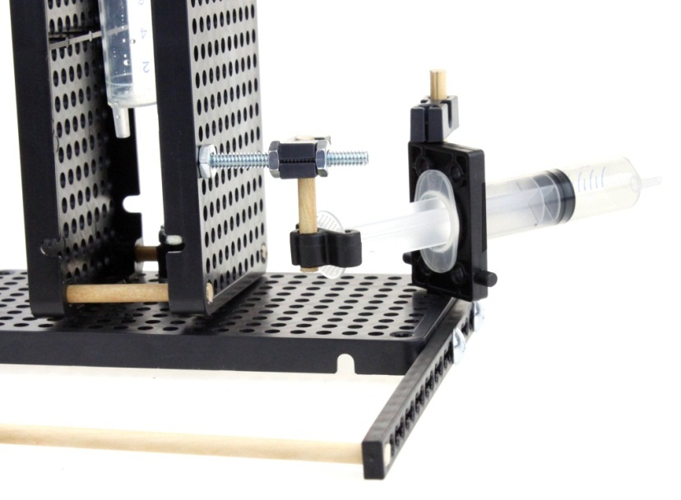
INSTALLING 10ML SYRINGE ON SWIVEL BASE
19
Insert a 10-24 x 1.5” machine screw from the inside out in the 6th hole up in the first vertical row as shown.
Install a 10-24 hex nut and tighten to the hole plate.
Thread a 2nd hex nut onto the machine screw leaving a 19mm (~3/4”) space between the hex nuts.
Cut dowel 39mm (~1 ½”) and insert into the center hole of a perpendicular adaptor.
Slide an end hole of the perpendicular adaptor on the machine screw so that it contacts the hex nut.
Install another 10-24 hex nut and tighten securely on the perpendicular adaptor.
20
Ream a large syringe clip and slide over the end of a 10ml syringe.
Press syringe into the syringe mount installed on the base and slide the reamed syringe clip up on to the dowel as shown.
First vertical row
6 holes up
Syringe
Clip Hole

Slide 15
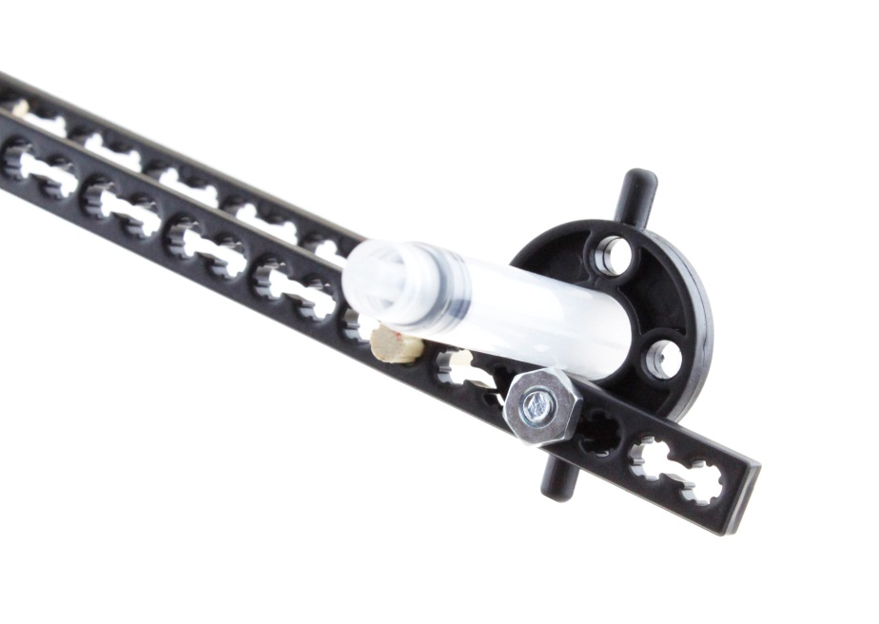
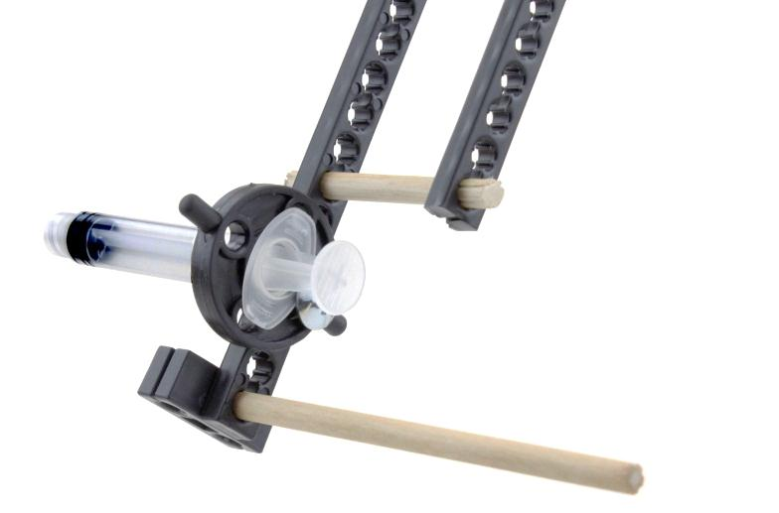
BUILDING THE GRIPPER
21
Insert 3ml syringe into a 3ml syringe holder.
Place a 10-24 x 1” machine screw into the syringe holder and into the 4th hole of the longer connector strip of the upper arm component.
Tighten securely with a 10-24 hex nut.
22
Cut dowel 90mm (~4 ½”).
Slide the dowel in the last hole of the connector strip so that it extends 13mm (~3/4”) to the outside.
Over that 13mm (~3/4”) extension slide a perpendicular adaptor through its center hole. The dowel will still extend beyond the adaptor.

Slide 16
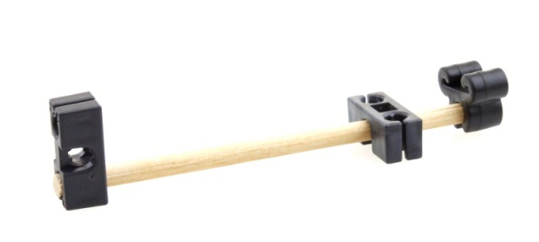
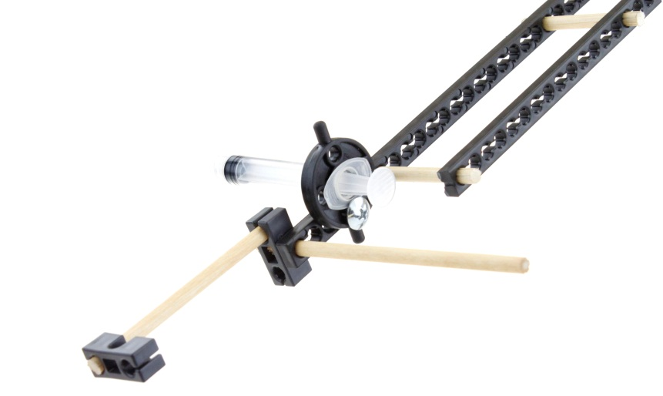

FINISH BUILDING THE GRIPPER
24
Cut a dowel 115mm (~4 ½”).
Slide the dowel through the center hole of a perpendicular adaptor so 25mm ( 1”) extends through the other side.
Slide a small syringe clip over the other end as shown.
Ream the hole shown in the perpendicular adaptor that is closest to the syringe clip.
23
Cut dowel 90mm (~3 ½”).
Slide this dowel in the end hole of a perpendicular adaptor.
Slide this dowel and adaptor into the top hole of the adaptor already installed on the gripper as shown.
25
Slide the reamed hole of the assembly in step 20 over the gripper dowel as shown.
Install the small syringe clip over the end of the syringe.
Place a Teacher Geek Clip on the end of the dowel as shown.
Reamed hole
slides freely on dowel.

Slide 17
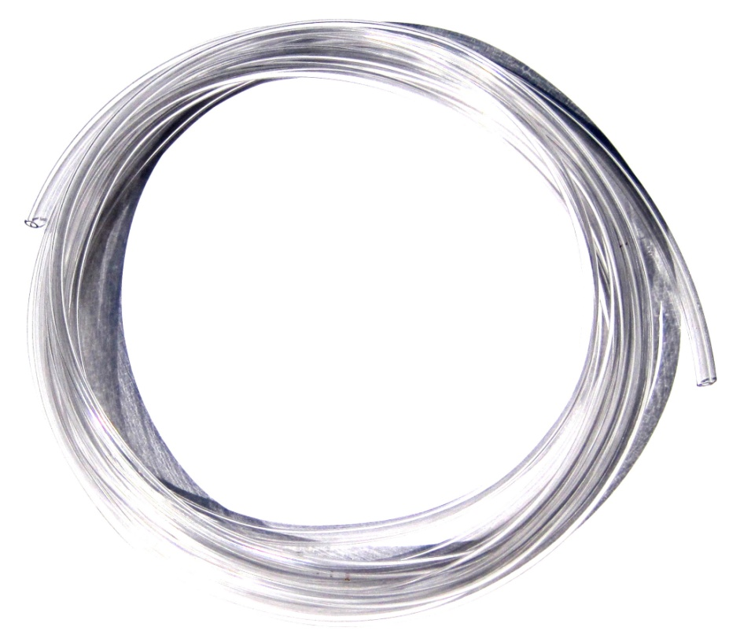
CUT VINYL TUBING TO LENGTH
26
Cut four lengths of tubing as indicated below.
80cm (~32 in.) BASE MOUNTED ROTATING SYRINGE TUBING
80cm (~32 in.) LOWER ELEVATING SYRINGE TUBING
110 cm (~42 in.) MID ARM SYRINGE TUBING
140cm (~54 in.) GRIPPER SYRINGE TUBING

Slide 18
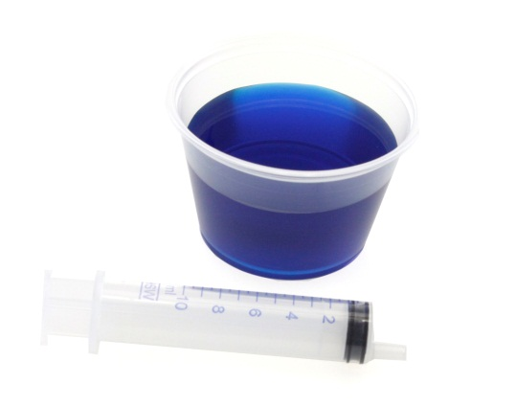
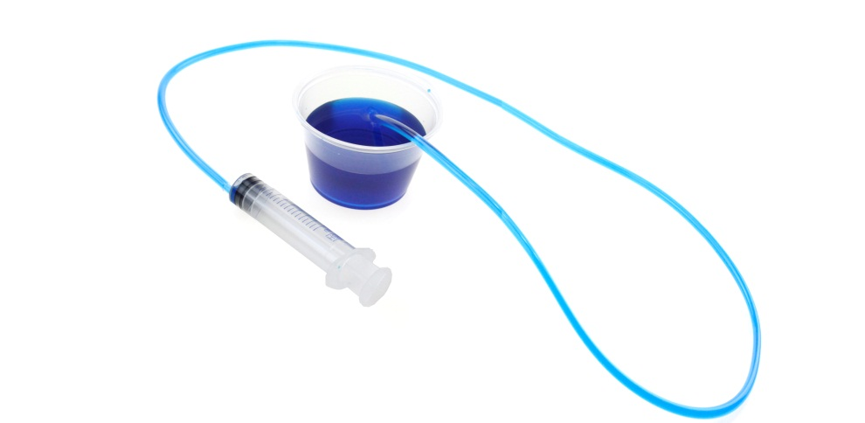
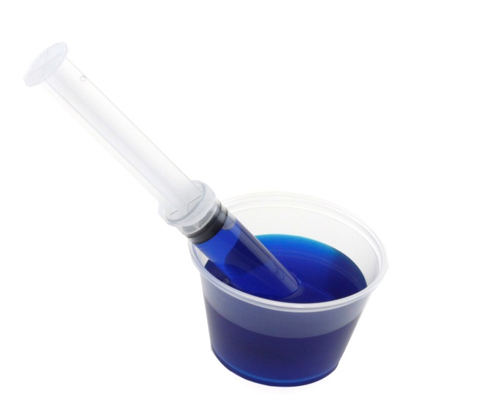
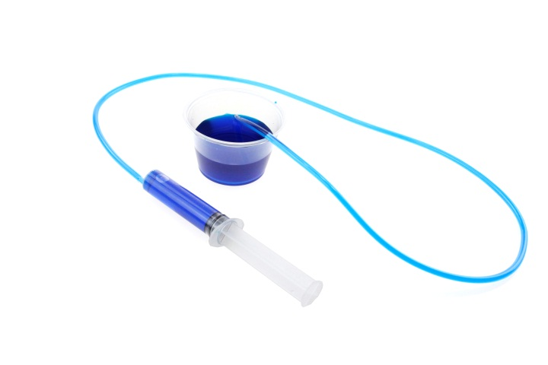
FILLING SYRINGES AND TUBING
28
Place tubing over end of syringe and other end into the water.
Depress syringe fully to fill tubing.
Water coloring is optional.
29
Keeping the end of the tubing in the water, draw a full 10ml of water into the syringe.
27
Place fully depressed syringe into water.
Draw a full 10 ml into the syringe.

Slide 19
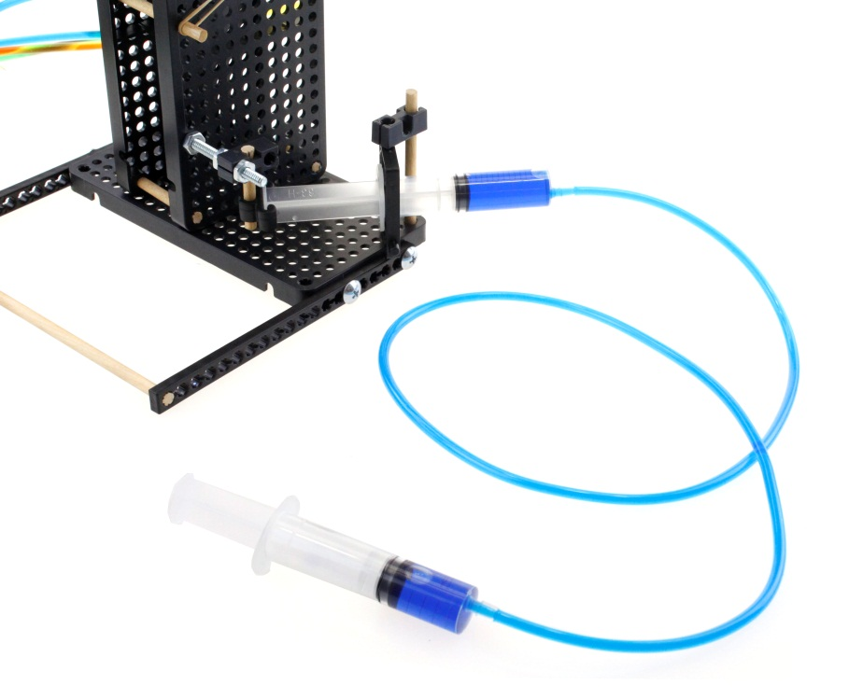
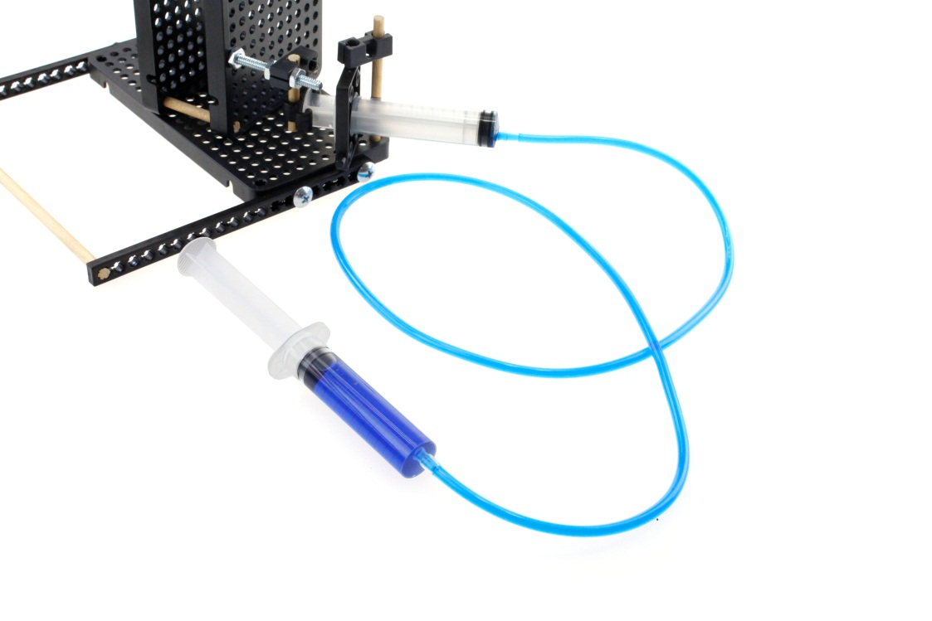
FILLING SYRINGES AND TUBING
31
Place end of filled tube on to the base mounted syringe.
30
Push the mounted syringe plunger
all the way in as shown.
32
Push and pull the control syringe to rotate the rotating base.

Slide 20
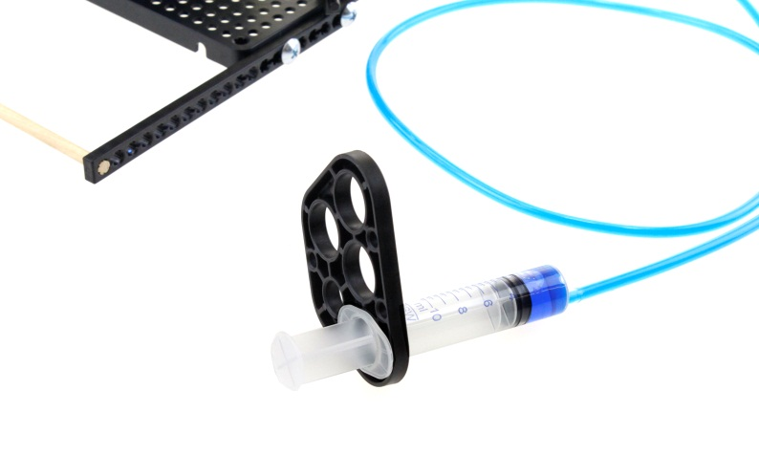
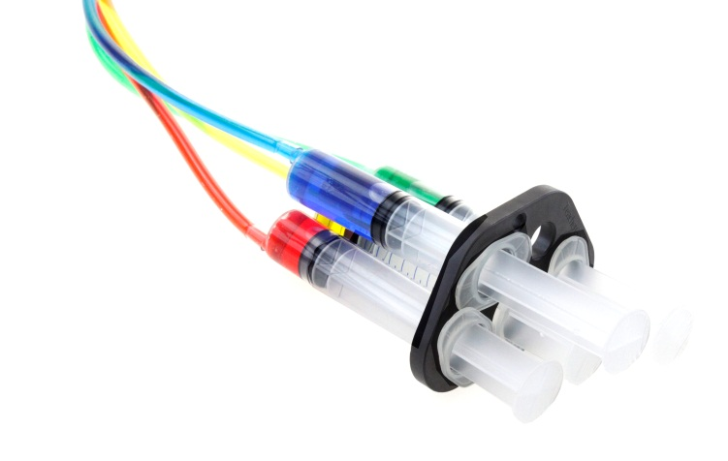
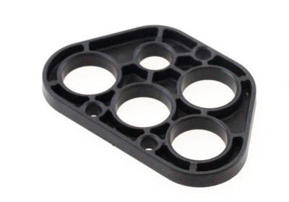
INSTALLING SYRINGES INTO CONTROL PANEL
34
Insert syringe into a hole on control panel.
35
Squeezing the end of the tubing to remove any air bubbles, slide back on to the control syringe.
Control Syringe
36
Repeat with the three remaining control syringes.
The gripper syringe is only 3ml so when filling the 10ml control syringe, stop at 3ml.
33
Carefully disconnect filled tubing from control syringe.
Control Panel

Slide 21
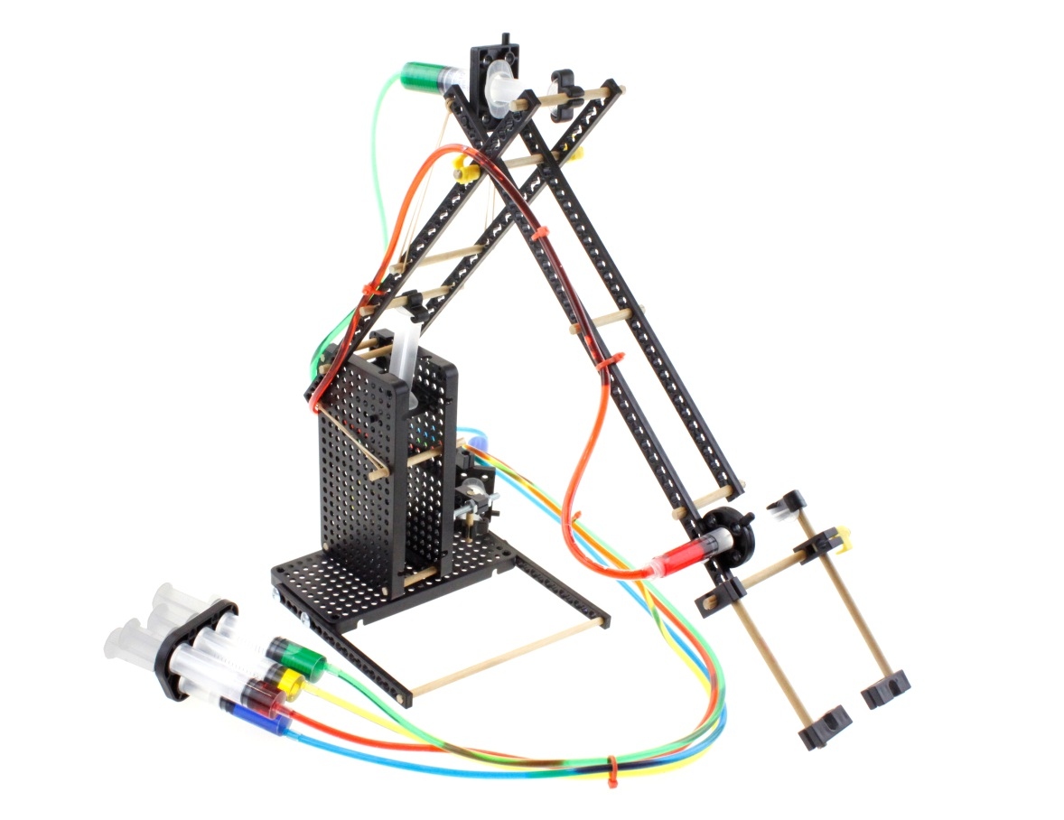
SECURE THE TUBING TO ARM
IMPORTANT TIPS
110cm Tubing
37
Using twist ties or zip ties, secure the tubing to arm. Also group together the four tubes going to control panel.
Leave the ties slightly loose so they do not restrict the water flow through the tubes.
Be sure the tubing has enough slack so as to not restrict the movement.
140cm Tubing
80cm Tubing
Both 80cm tubing sections go from control panel to the arms lower cylinders.

Slide 22
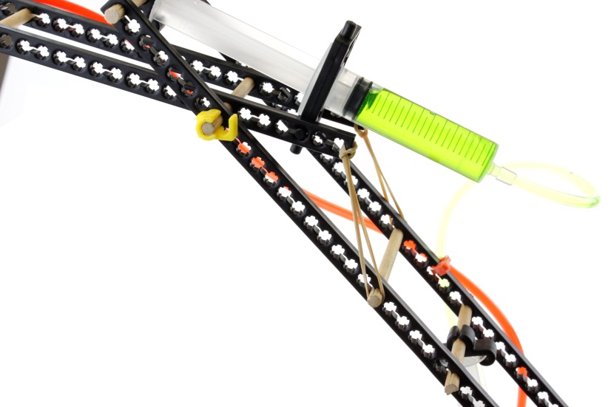
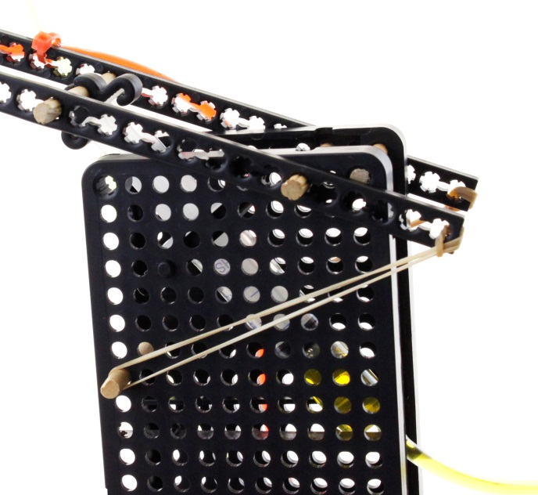
CREATING COUNTER BALANCE WITH RUBBER BANDS
39
Loop rubber bands through the end of both lower arm connector strips.
Ream the 8th hole down in the first vertical row of the hole plates (both sides).
Cut a 76mm (~3”) dowel and insert into the reamed holes.
Hook the other end of the rubber bands over the dowel ends as shown.
38
Loop rubber bands through the end of both upper arm connector strips.
Hook the other end of the rubber bands over the dowel extensions as shown.
8th Hole Down

Slide 23

THE FINISHED HYDRAULIC ARM
3

