Slide 1
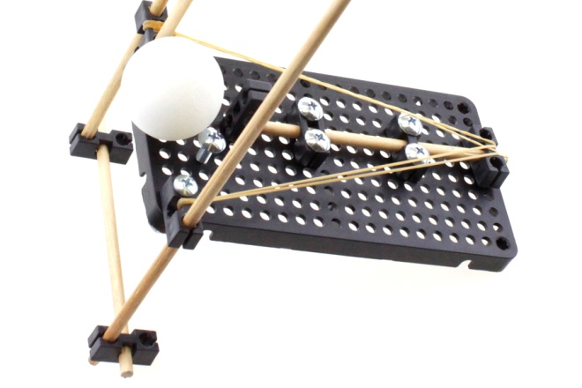
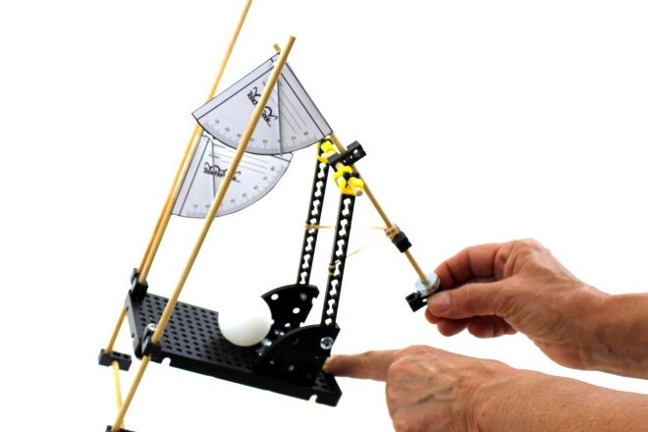
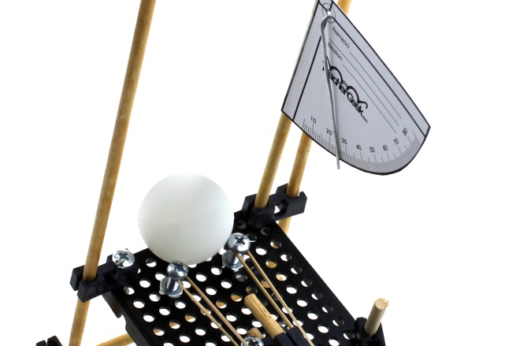
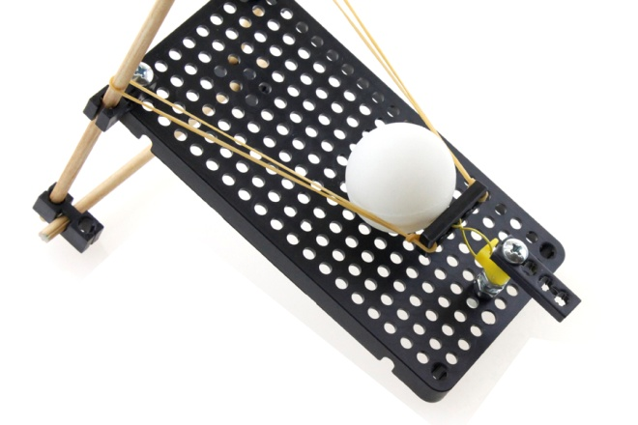
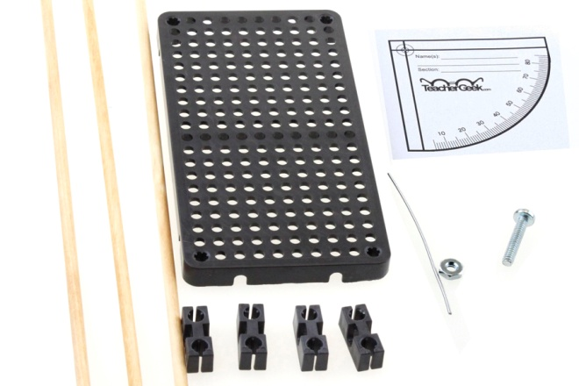

Slide 2
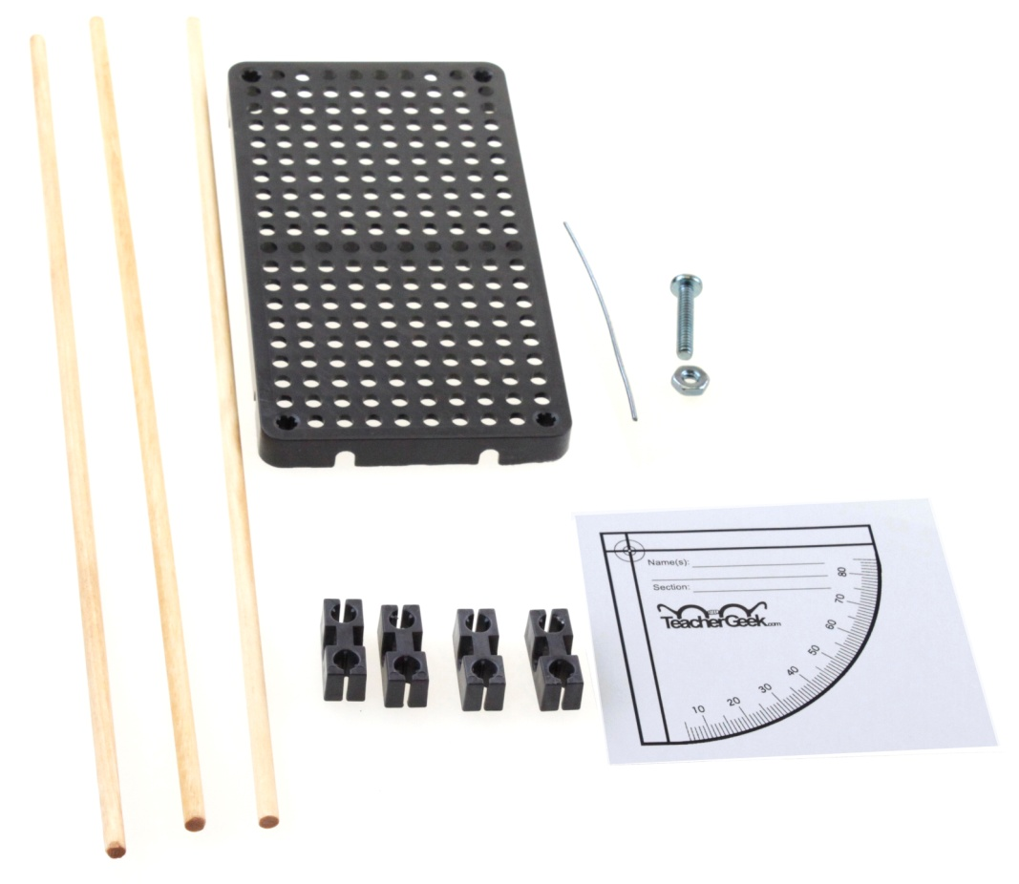
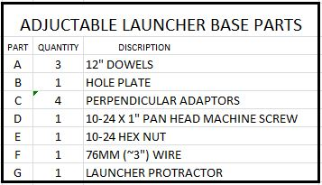
LAUNCHER BASE PARTS
B
A
D
E
F
C
G

Slide 3
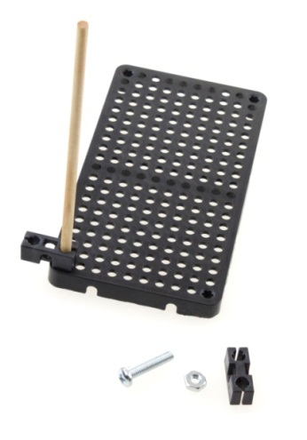
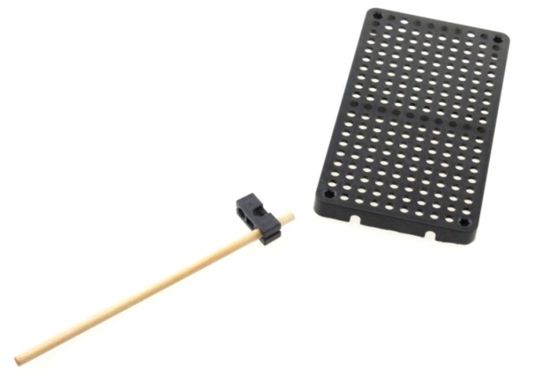
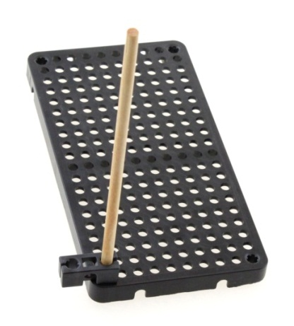
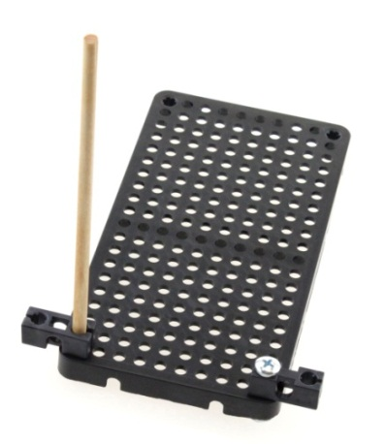
ASSEMBLING THE LAUNCHER BASE
1
Cut one 300mm (~12”) dowel into two 150mm (~6”) pieces.
Slide one of these dowel pieces into the end hole of a perpendicular adaptor so it extends 10mm (3/8”) through the other side as shown.
10-24 x 1” Machine Screw and Nut
3
Attach the other perpendicular adaptor to the other corner with a 10-24 x 1” machine screw and hex nut as shown.
2
Slide that dowel end into the corner hole of the hole plate as shown

Slide 4
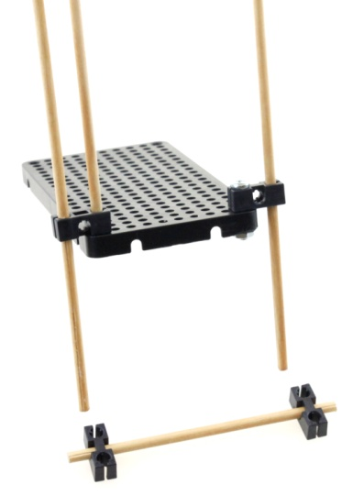
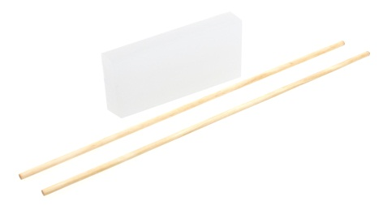
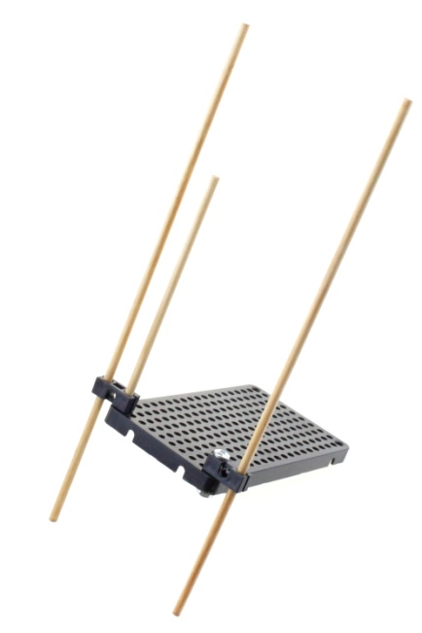
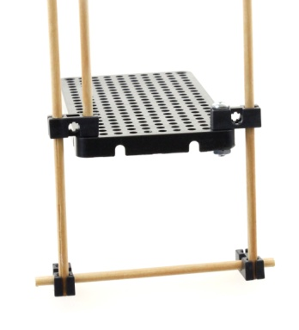
ASSEMBLING THE LAUNCHER BASE
4
Slide the two remaining 300mm (~12”) dowels over a block of paraffin wax to aid sliding for height adjustments.
6
Cut the remaining 150mm (~6”) dowel down to 125mm (~5”).
Slide the center hole of two perpendicular adaptors onto each end of this dowel so it protrudes 10mm (~3/8”) on each end.
5
Slide the two dowels down through the outside holes of the perpendicular adaptors mounted to the hole plate.
7
Insert the ends of the dowels mounted on to the base into the front holes of the perpendicular adaptors as shown.

Slide 5
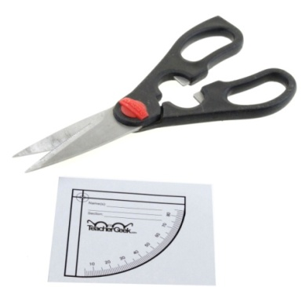
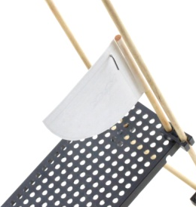

ASSEMBLING THE LAUNCHER PROTRACTOR
8
Download and print the launcher protractor from the TeacherGeek website.
Using scissors, carefully cut this out.
10
Poke the hook end through the circle in the corner of the protractor so the long part of the wire hangs over the front.
9
Bend a hook about 12mm (~1/2”) from the end of a 75mm (~3”) wire as shown.
11
Tape the assembled protractor to the top of the 150mm (6”) dowel as shown.

Slide 6
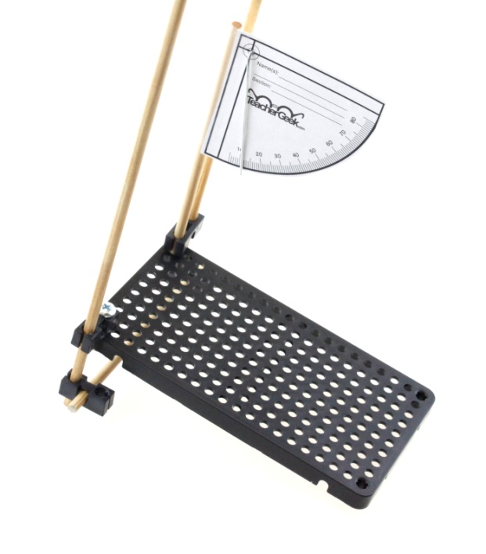
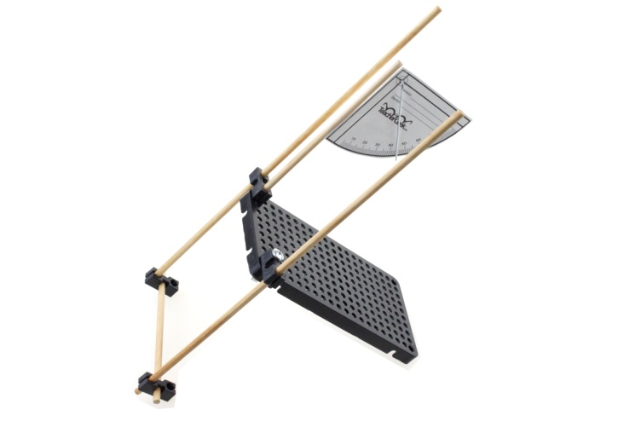
THE COMPLETED LAUNCHER BASE
12
The completed base is now ready for launcher assembly. Sliding the dowels as shown allows for angle adjustments.
Note the protractor wire indicates the angle in degrees.

Slide 7
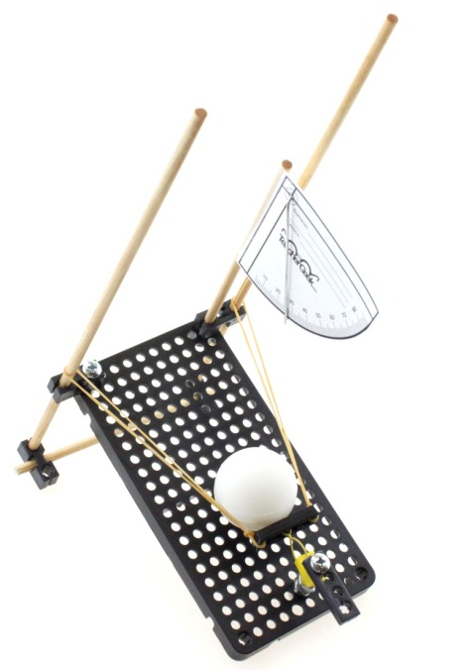
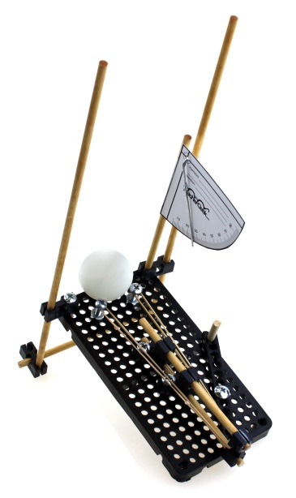
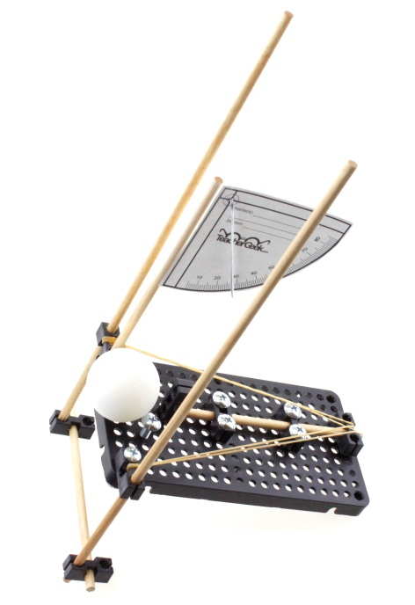
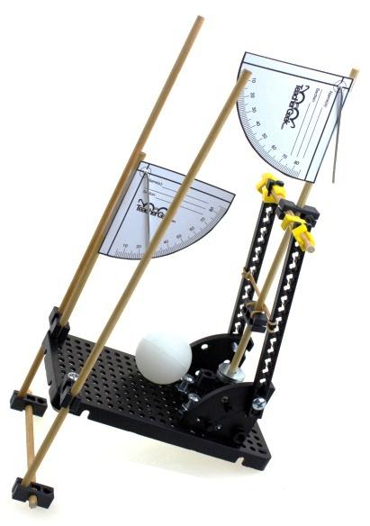
THE LAUNCHER ASSEMBLY
Launching a ball from the adjustable base can be done in many ways. This is where individual design, creativity and problem solving lead to unique ways to achieve goals. Whether for accuracy, height, distance or any combination, solutions are endless.

Slide 8

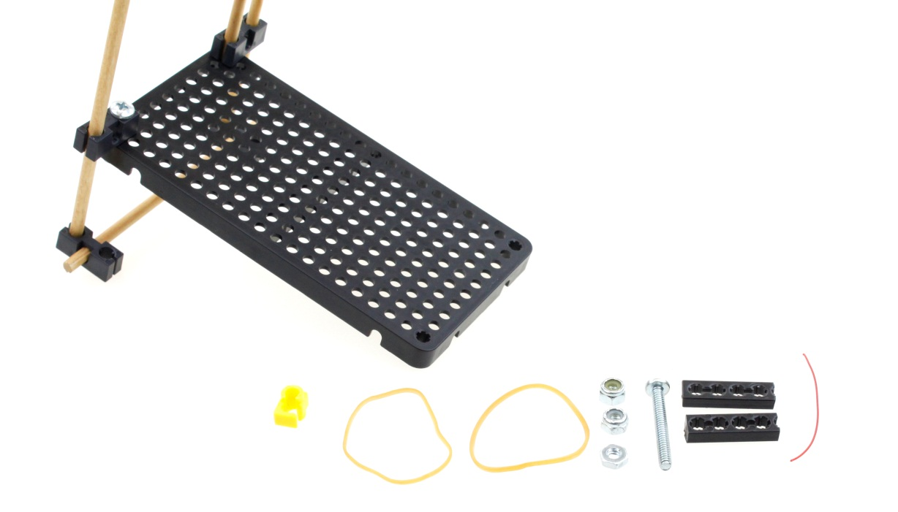
SAMPLE LAUNCHER ASSEMBLY
The following pages provide just one simple example of how a launcher can be constructed on the adjustable base. Use your imagination and additional TeacherGeek parts to design other creative ways to launch the ball to achieve the desired result.
A TeacherGeek Clip
B Rubber Bands
C Locking 10-24 Hex Nuts
D 10-24 Hex Nut
E 10-24 x 1 ½” Machine Screw
F Connector Strip Pieces 32 mm(~1 ¼”)
G Wire 64mm (~2 ½”)
C
E
F
G
A
B
D

Slide 9
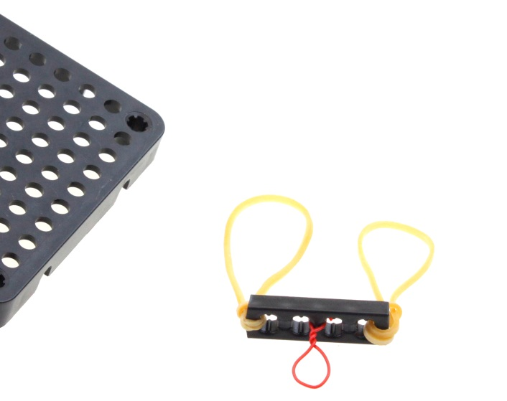
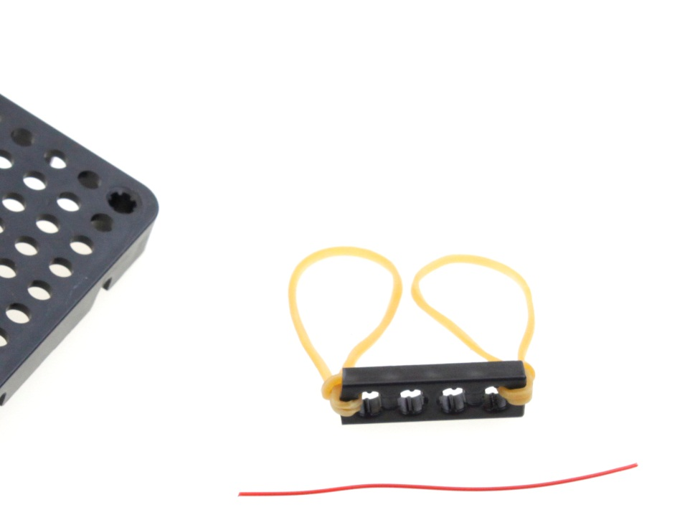
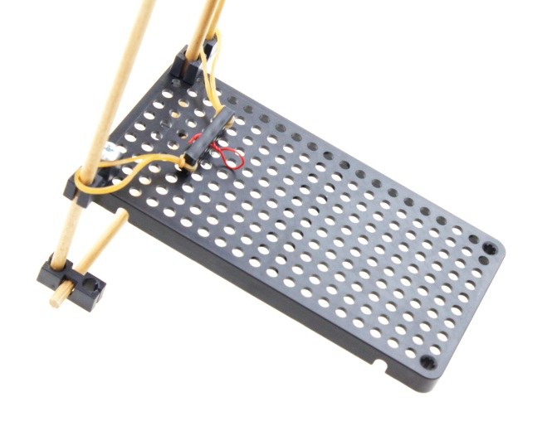
SAMPLE LAUNCHER ASSEMBLY
3
Place the ends of the wire through the two center holes of the connector strip.
Twist a loop on one side as shown.
Twist the two ends together on the other side to secure the loop to the center post of the connector strip.
1
Cut a connector strip 32mm (~1 ¼”) long.
Loop rubber bands through both end holes.
4
Slide the rubber bands over two support dowels as shown.
2
Cut a 64mm (2 ½”) piece of wire that will form the trigger loop.

Slide 10
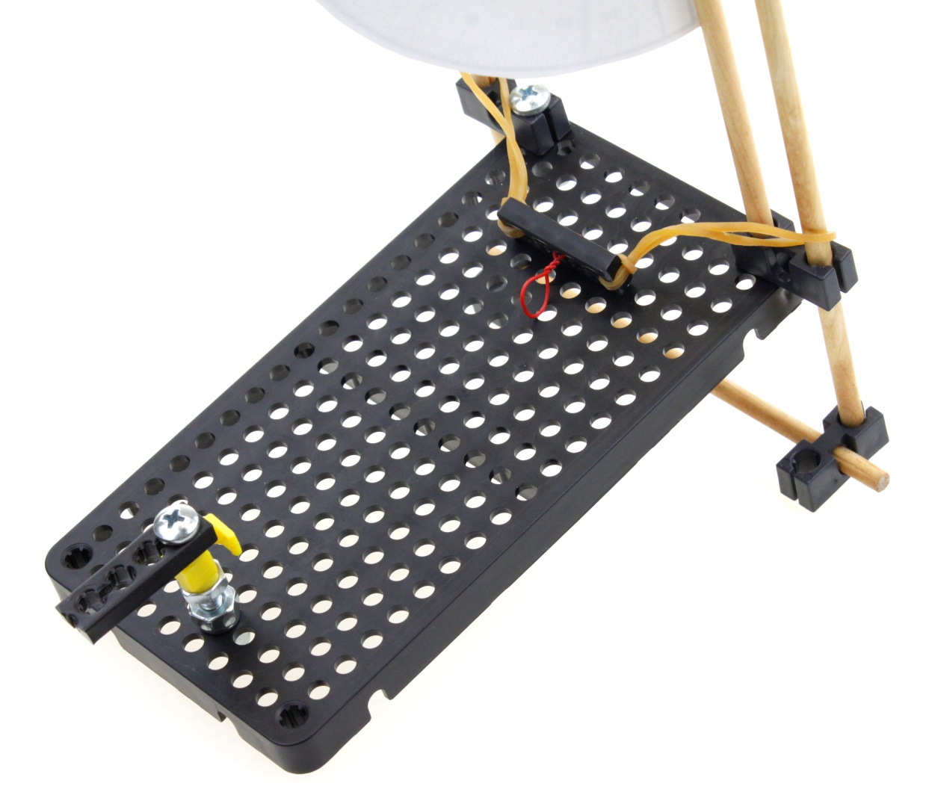
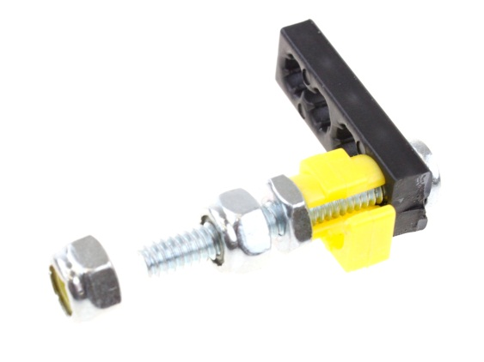
SAMPLE LAUNCHER ASSEMBLY
5
Cut a connector strip 32 mm (~1 ¼”) long.
Insert the 10-24 x 1 ½” machine screw through the end hole.
Slide a TeacherGeek clip on and tighten snugly with a 10-24 nut.
Thread a 10-24 locking nut on so it is 5mm (~1/4”) from the other nut.
6
Insert the end on the 10-24 1 ½” machine screw into the hole plate as shown.
Thread the other locking nut on the under side and tighten so the machine screw can still rotate.

Slide 11
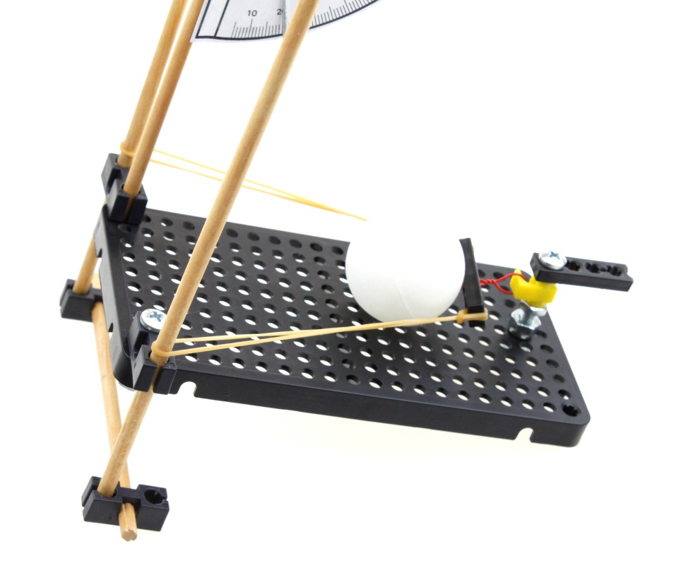
SAMPLE LAUNCHER ASSEMBLY
Pull the rubber band back and place the wire loop over the TeacherGeek clip.
Place the ping pong ball as shown.
Rotating the trigger assembly will launch the ball.

